Slide 1

Credit rating
Principal component analysis, k-means clustering, linear interpolation, lowest-coefficients fitting

Slide 2



WHERE WE WERE LAST TIME?
The Model Was Not Sophisticate Enough
K-Means Clustering Algorithm alone cannot answer which groups are good or bad
Issues in Variable Selection
We have to choose the variables ourselves, which might be incomplete and biased. Selected variables might exhibit strong pair-wise correlation, resulting in double effects
Lack of implication of Credit Scoring
We was even not sure at which price a stock should be valued given its credit score

Slide 3
Counter the problems
1
2
3
4
5
Inter-quartile Range Method
Principal Component Analysis
K-Means Clustering Algorithm
Linear Interpolation
Lowest-Coefficients Regression
Data Standardization
Variable Selection
Grouping
Scoring
Pricing

Slide 4
Counter the problems
1
2
3
4
5
Inter-quartile Range Method
Principal Component Analysis
K-Means Clustering Algorithm
Linear Interpolation
Lowest-Coefficients Regression
Data Standardization
Variable Selection
Grouping
Scoring
Pricing

Slide 5
Data Standardization Inter-quartile Range Method (IQR)
-1
0
1
mean value

Slide 6
Counter the problems
1
2
3
4
5
Inter-quartile Range Method
Principal Component Analysis
K-Means Clustering Algorithm
Linear Interpolation
Lowest-Coefficients Regression
Data Standardization
Variable Selection
Grouping
Scoring
Pricing

Slide 7
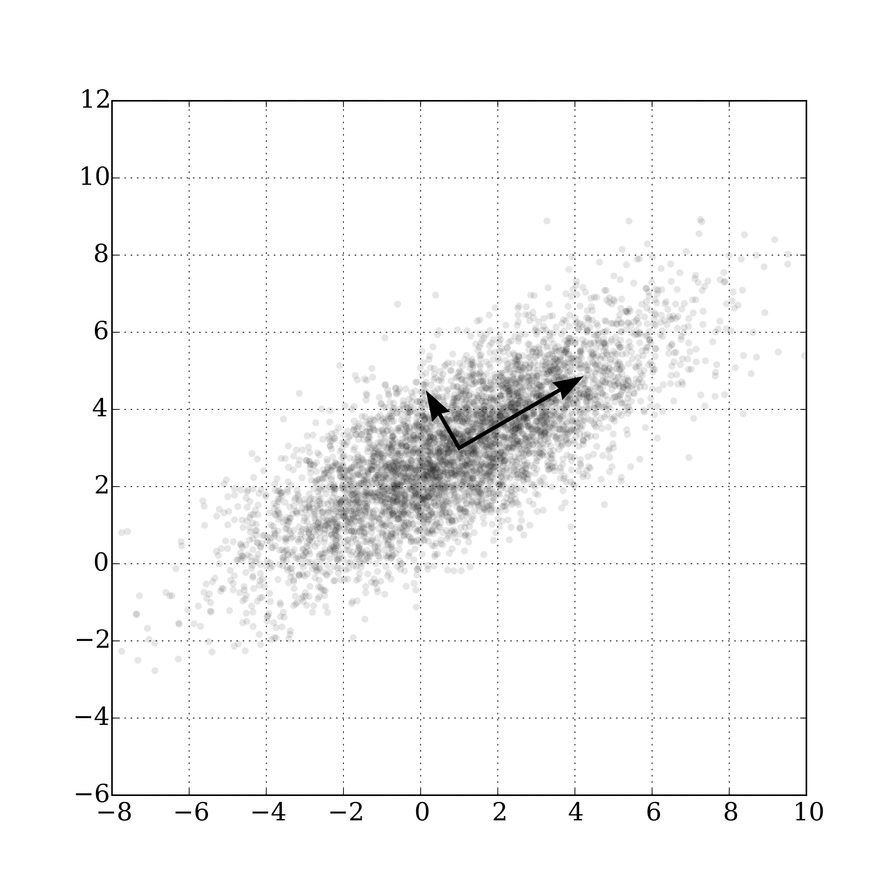
Variable selection Principal Component Analysis (PCA)
Remove correlation between variables, avoid double effect
Change of basis is a linear transformation, which preserves distance between data points

Slide 8
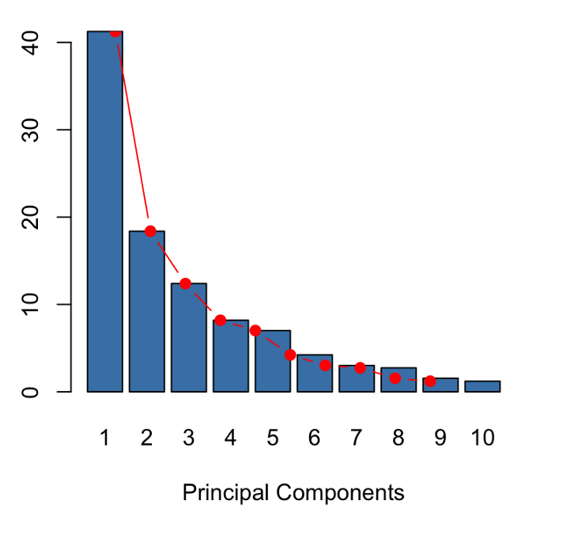
Variable selection Principal Component Analysis (PCA)
We can thrown a bunch of variables into the model. The model can produce a set of much fewer variables, called principal components (which are completely uncorrelated) that describes most of the input variables
Explained Percentage
PCA extracts the most important information from that pool of variables
We do not have to choose the variables ourselves
The more variables thrown into the model, the more confidence we have that we capture “all” financial aspect of a companies

Slide 9
Variable selection – General industry Principal Component Analysis (PCA)
Altman Z-score: (5 variables)
Working Capital / Total Assets
Retained Earnings / Total Assets
EBIT/ Total Assets
Equity / Total Liabilities
Sales / Total Assets
Fulmer H-score: (9 variables)
Retained Earnings / Total Assets
Revenue / Total Assets
EBIT / Equity
OCF / Debt
Debt / Equity
Current Liabilities / Total Assets
log(Tangible Assets)
Working Cap / Debt
EBIT / Interest Expense
Fiin Group Key Indicators (17 variables)
Return on Capital Employed (ROCE)
Account Receivables Turnover
Inventories Turnover
Payable Turnover
Asset Turnover
Equity Turnover
Cash Ratio
Quick Ratio
Current Ratio
Long-term Debt / Equity
Long-term Debt / Total Assets
Debt / Equity
Debt / Total Assets
Short-term Debt / Equity
Short-term Debt / Total Assets
Liabilities / Equity
Liabilities / Total Assets
Beneish M-score: (8 variables)
Days Sales in Receivables Index
Gross Margin Index
Asset Quality Index
Sales Growth Index
Depreciation Index
SG&A Expenses Index
Leverage Index
Total Accruals to Total Assets
I don’t care, take ׳em all
Many more from online research papers…

Slide 10
Variable selection Principal Component Analysis (PCA)
General Industries:
46 variables
Banking:
37 variables
Reduced to a half number of PCs
Insunrance:
29 variables
Brokerage:
25 variables

Slide 11
Counter the problems
1
2
3
4
5
Inter-quartile Range Method
Principal Component Analysis
K-Means Clustering Algorithm
Linear Interpolation
Lowest-Coefficients Regression
Data Standardization
Variable Selection
Grouping
Scoring
Pricing

Slide 12
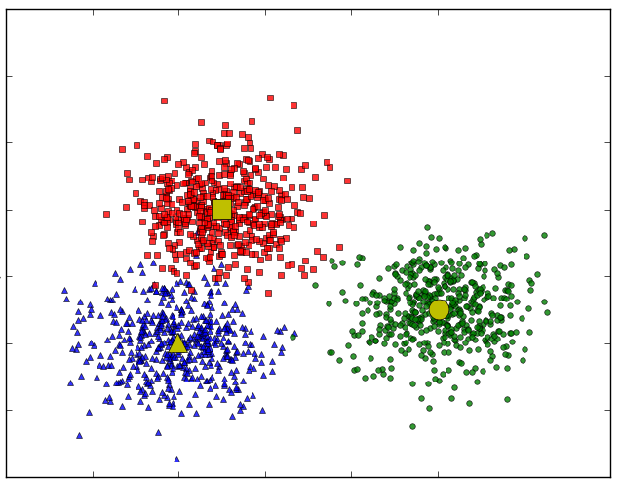
Grouping K-Means Clustering Algorithm
Example in 2D space
1
K-Means facilitates grouping (or classifying) data points in multi-dimensional space
Each group is represented by a centroid (center of that group)
PC2
Each data point represents a company
-1
-1
PC1
1

Slide 13
Counter the problems
1
2
3
4
5
Inter-quartile Range Method
Principal Component Analysis
K-Means Clustering Algorithm
Linear Interpolation
Lowest-Coefficients Regression
Data Standardization
Variable Selection
Grouping
Scoring
Pricing

Slide 14
Scoring Linear Interpolation
1
We assign credit scores for every points on the boundary curves:
Boundary curve 1: 25
Boundary curve 2: 50
Boundary curve 3: 75
×
×
×
82
97
67
Centroid 3
Centroid 2
×
38
Boundary Curve 3
Linear Interpolation is used to compute the credit score of any company lies between 2 boundary curves
×
×
44
×
18
62
Centroid 1
×
×
31
14
-1
-1
Boundary Curve 1
Boundary Curve 2
1

Slide 15
Counter the problems
1
2
3
4
5
Inter-quartile Range Method
Principal Component Analysis
K-Means Clustering Algorithm
Linear Interpolation
Lowest-Coefficients Regression
Data Standardization
Variable Selection
Grouping
Scoring
Pricing

Slide 16
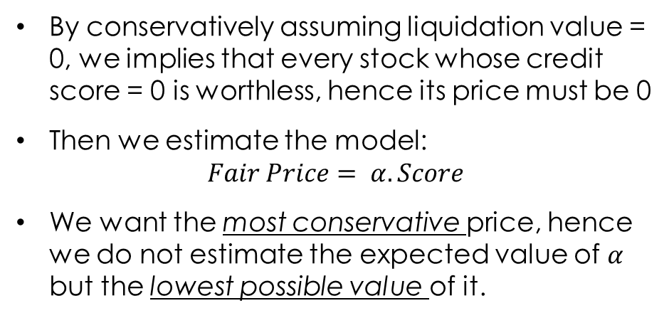


Pricing Lowest Possible Coefficients Regression
Price
By conservatively assuming liquidation value = 0, we implies that every stock whose credit score = 0 is worthless, hence its price must be 0
Then we estimate the model: $Fair Price= α.Score$
We want the most conservative price, hence we do not estimate the expected value of $α$ but the lowest possible value of it.
$$α_{lowest}$$
$$\overline{α}$$
Liq
95% confidence interval
0
Score

Slide 17

Result

Slide 18
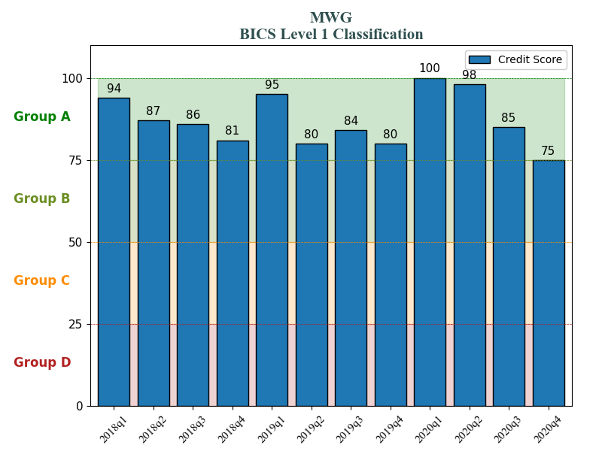
general industries HOSE: MWG - Mobile World Investment Corporation
general industries HOSE: MWG - Mobile World Investment Corporation

Slide 19
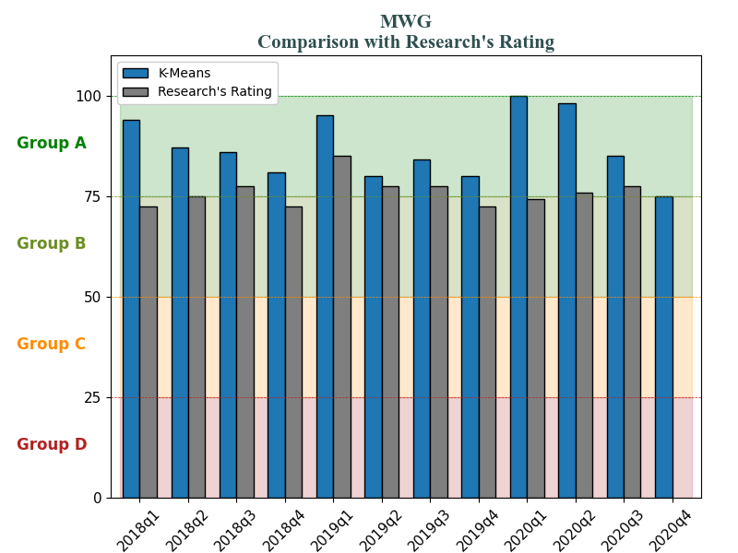
general industries HOSE: MWG - Mobile World Investment Corporation
general industries HOSE: MWG - Mobile World Investment Corporation

Slide 20
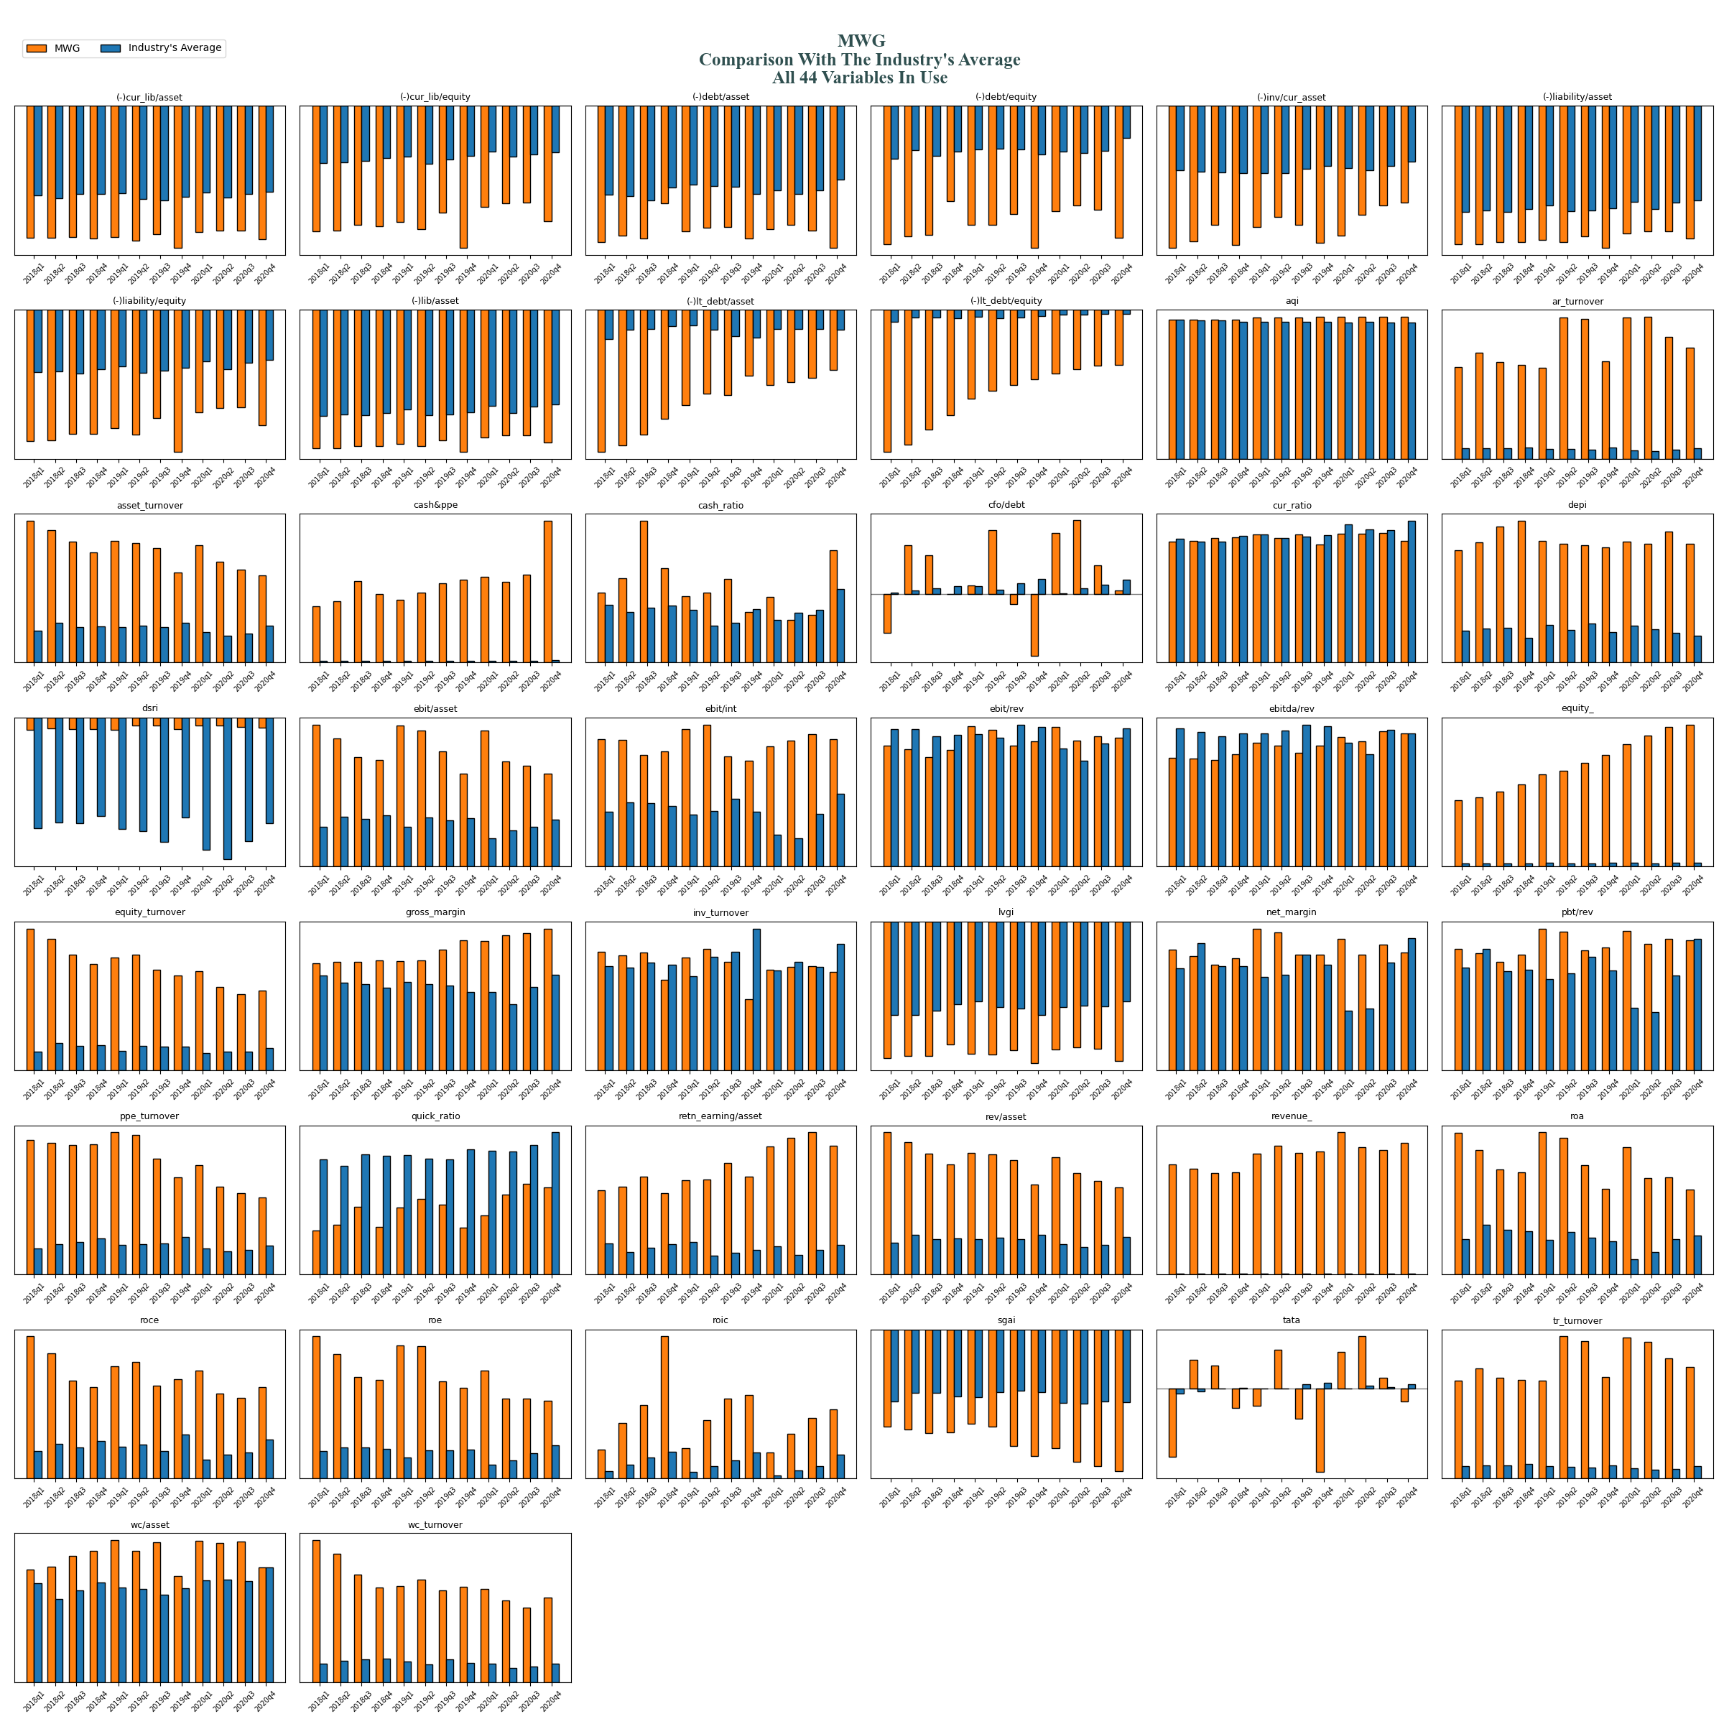
general industries HOSE: MWG - Mobile World Investment Corporation

Slide 21
general industries HOSE: MWG - Mobile World Investment Corporation

Slide 22

Thank You

